Slide 1
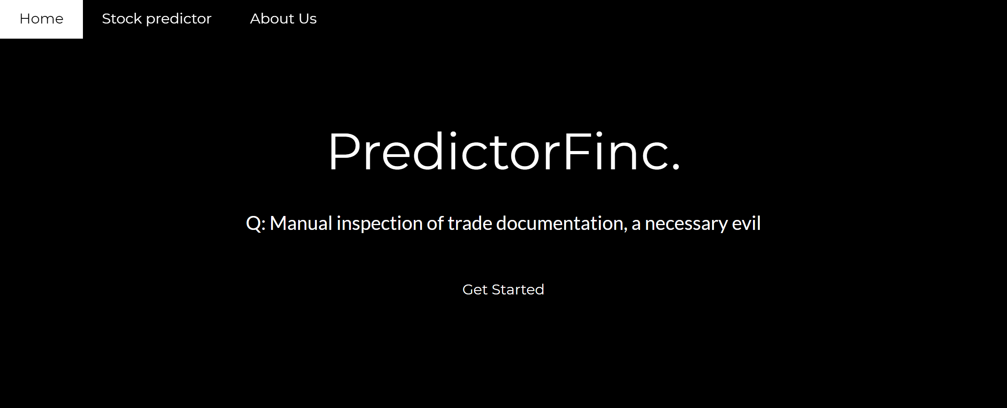

BillionairBerg
The Team

Slide 2

Developed By
Aditya Jain (aj2529) MS, Computer Science

Slide 3

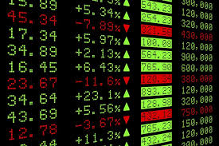
MOTIVATION / PROBLEM STATEMENT
The Stock market process is full of uncertainty and it’s affected by many factors. Hence the Stock market Analysis is one of the important exertions in business and finance.
A prediction model has been built that uses big data analytical capabilities and machine learning to snalyze the trend about stock markets

Slide 4
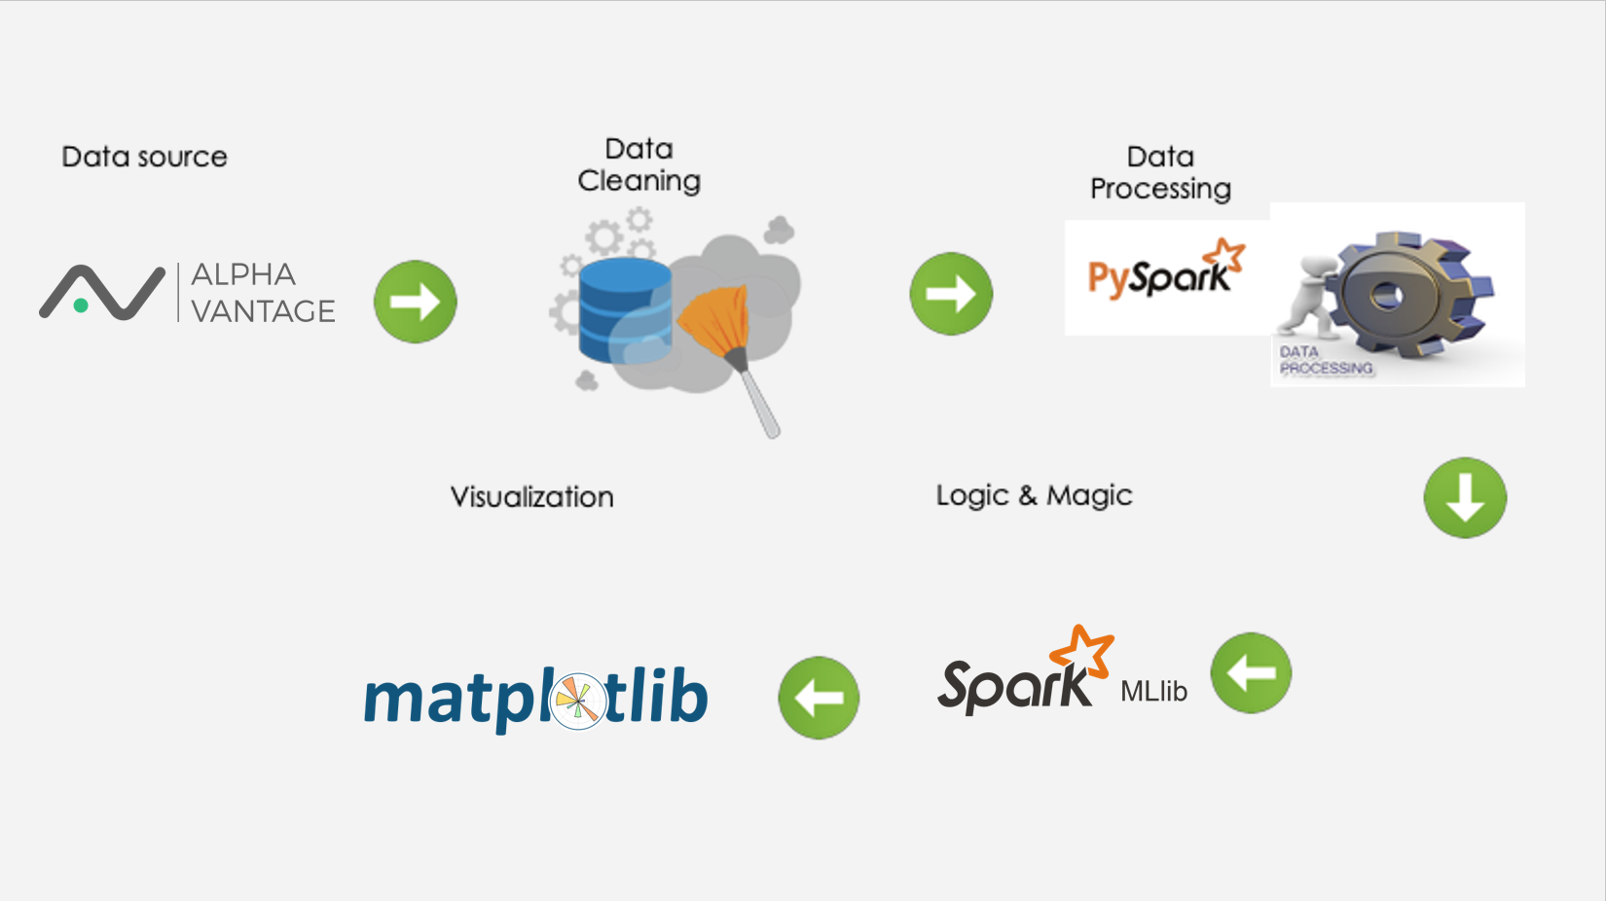
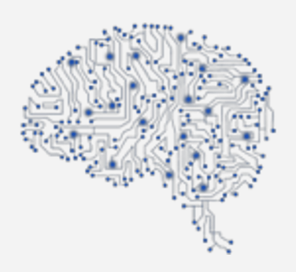
PROJECT PIPELINE STRUCTURE

Slide 5
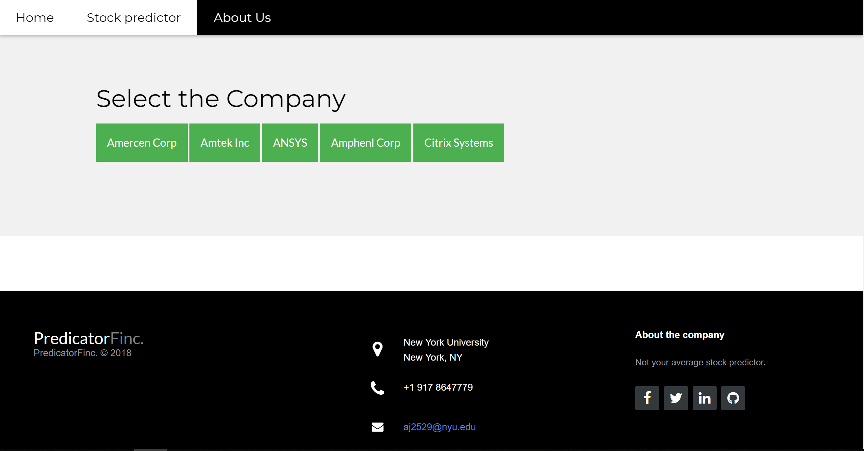
THE UI

Slide 6
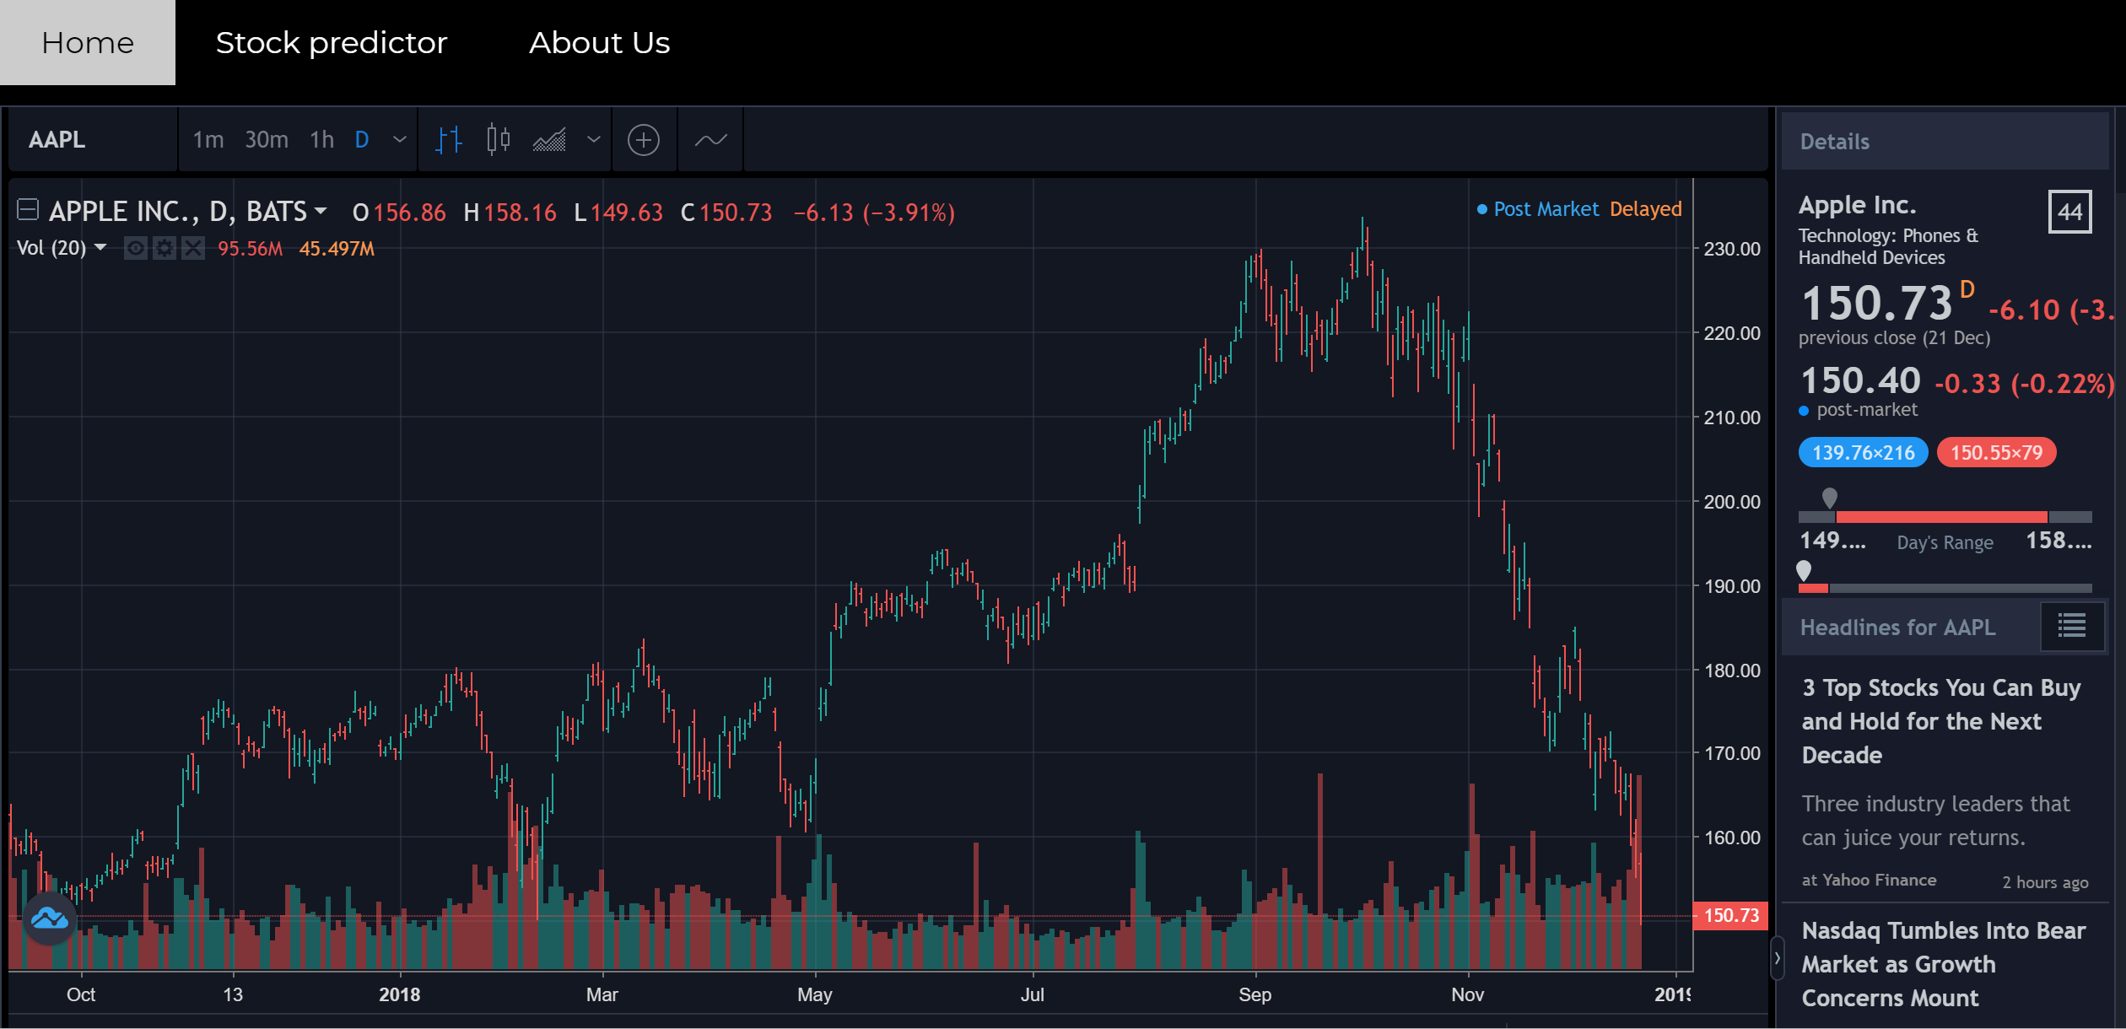
THE UI

Slide 7
DATA SOURCE
Stock data
From Last 5 years
Stock Price Change Prediction
GLOBAL LAND TEMPERATURE
DATA SET
We used spark to analyze the stock values of 500 companies and took data from AlphaVantage API.
In order to predict stock we decided to explore the high, low, opening value and closing value of stock dataset of 20 years
Finally we are able to predict the stock prices for the given company

Slide 8
Identified the AlphaVantage API for Data Collection
Using Decision Tree Classifier to predict the stock prices change
Visualized the data with respected to the trained data
STEP - 1
STEP -2
STEP - 3
STEP - 4
STEP -5
Made the model more scalable using PySpark
Cleaned the data to get the required features by using data frames

Slide 9



3 Phases
Data Cleaning
Machine Learning Analytics
- MLib
- PySpark
Data Visualization

Slide 10
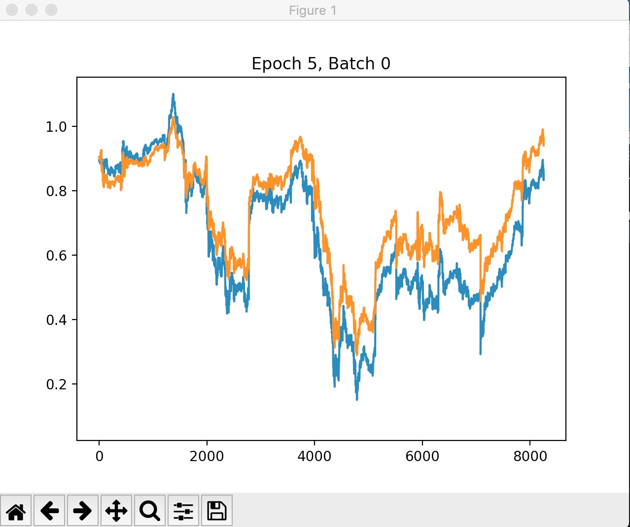
Our Prediction

Slide 11
LESSONS LEARNED
Data Cleaning, removing non-informative attributes, feature engineering using Spark on NYU HPC.
Integrating Jupyter Notebook with PySpark, Spark .
Applying machine learning algorithms to the Big Data files to make future predictions using Spark MLlib.
Performing Big Data on live clusters.

Slide 12
PROBLEMS WE RAN INTO
Integrating Jupyter notebook with Spark, PySpark and R on Windows
Data type casting problems for columns of Spark DataFrames
Permission issues in collecting stock price for a timeline of more than five months.
Identifying the important attributes from all the datasets, to train the Decision Tree.
Connection issues with NYU HPC while integrating

Slide 13
Conclusion
In this project, we determined that stock prices sparsely show similar patterns.
For prediction, we proposed a novel method based on a combination of Decision Tree Model in order to find similar historical patterns for each stock item and build a scalable model to predict the daily stock price
Moreover, we dealt with the overall process using a big data processing framework Spark.

Slide 14
Future Scope
Based on available data, predict the stock which is going to perform the best in the next and will give maximum returns.
Taking into account the twitter sentiments to determine the change in prices.
Provide suggestions for buying a particular buyer or stock broker, which could help them predict prices more accurately.

Slide 15
Technology Used
01
02
03
04
NYU HPC
PySpark
Spark MLib
Matplotlib
05
06
07
Python
WebDev
Jupyter

Slide 16

Thank You

